Slide 1


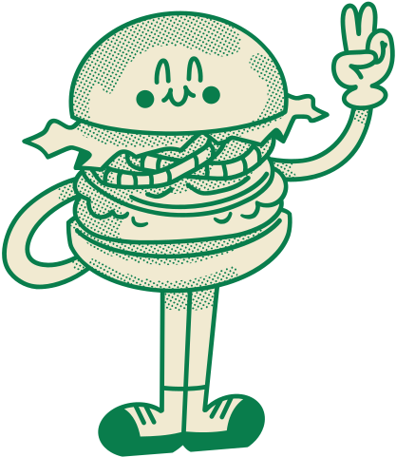

Problem ID: 2
Burger Buddies
Problem

Slide 2
Submitted by –
Rakibul Islam - 2021-3-60-030
Sagor Ahmed - 2021-3-60-117
Syeda Tasmiah Chowdhury Orpa - 2021-3-60-185
Nushrat Zahan - 2021-3-60-213
Submitted to –
Dr. Md. Nawab Yousuf Ali
Professor, Department of Computer Science and Engineering
East West University

Slide 3

Problem Description:
Cooks, Cashiers, and Customers are each modeled as a thread
Cashiers sleep until a customer is present
A Customer approaching a cashier can start the order process
A Customer cannot order until the cashier is ready
Once the order is placed, a cashier has to get a burger from the rack
If a burger is not available, a cashier must wait until one is made
The cook will always make burgers and place them on the rack
The cook will wait if the rack is full
There are NO synchronization constraints for a cashier presenting food to the customer.

Slide 4
Introduction:
The simulated scenario involves a restaurant-like setting with interactions between customers, cashiers, and cooks in a multithreaded system.
The goal is to ensure smooth cooperation and avoid issues like overloading or deadlocks.
Synchronization techniques like mutexes, condition variables, and threads are used to simulate a realistic restaurant environment.
This challenge explores thread synchronization and inter-process communication (IPC) techniques for creating a reliable method.

Slide 5
Cook’s Functionality:
The cook_func simulates the continuous activity of a cook in a restaurant.
It prepares burgers by sleeping for a random duration, then checks and increments the burger count on the rack, ensuring the rack doesn't exceed its capacity.
This process repeats indefinitely, representing ongoing cooking activity in the kitchen.

Slide 6
Cashier’s Functionality:
The cashier_func simulates continuous cashier activity in a restaurant.
It waits for customers, takes orders, retrieves burgers from the rack, and serves customers.
The cashier interacts with the shared rack, ensuring proper synchronization using semaphores.
This process repeats indefinitely, representing ongoing cashier-customer interactions.

Slide 7
Customer’s Functionality:
The customer_func simulates continuous customer activity in a restaurant.
It signals cashiers when ready to order, waits for a cashier to take the order, simulates order placement, receives burgers, and repeats the process.
Proper synchronization using semaphores ensures orderly interactions between customers and cashiers in a concurrent environment.

Slide 8
Let’s Run The Code!

Slide 9
Thank
you!

